Slide 1


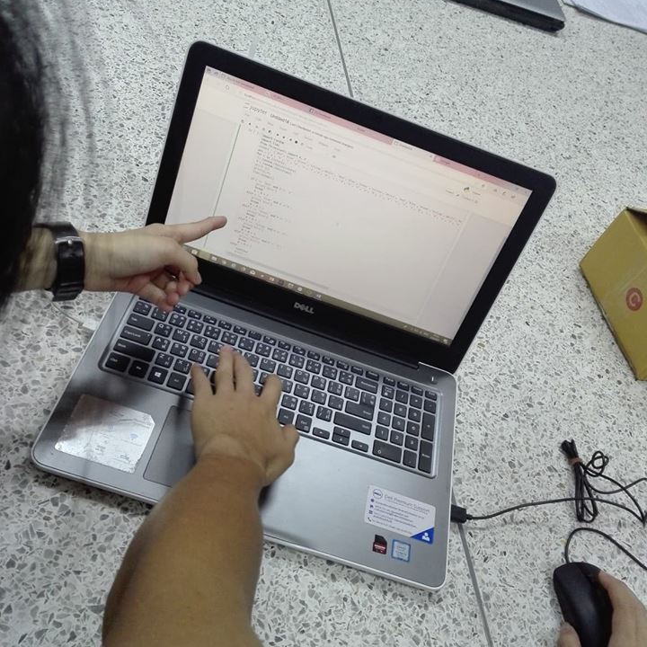
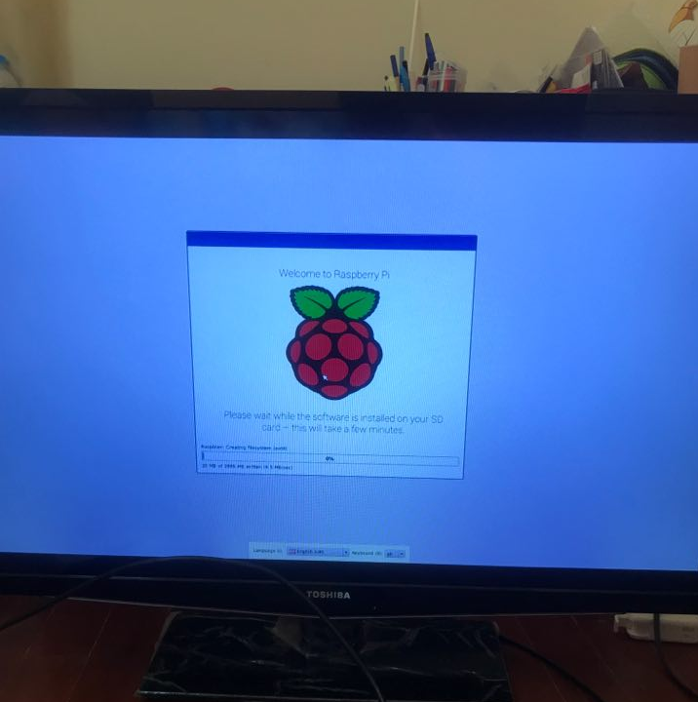
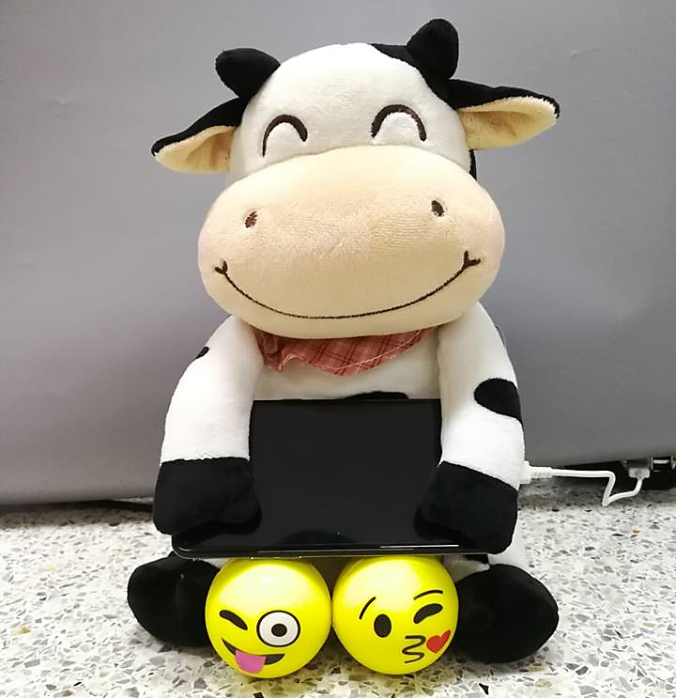
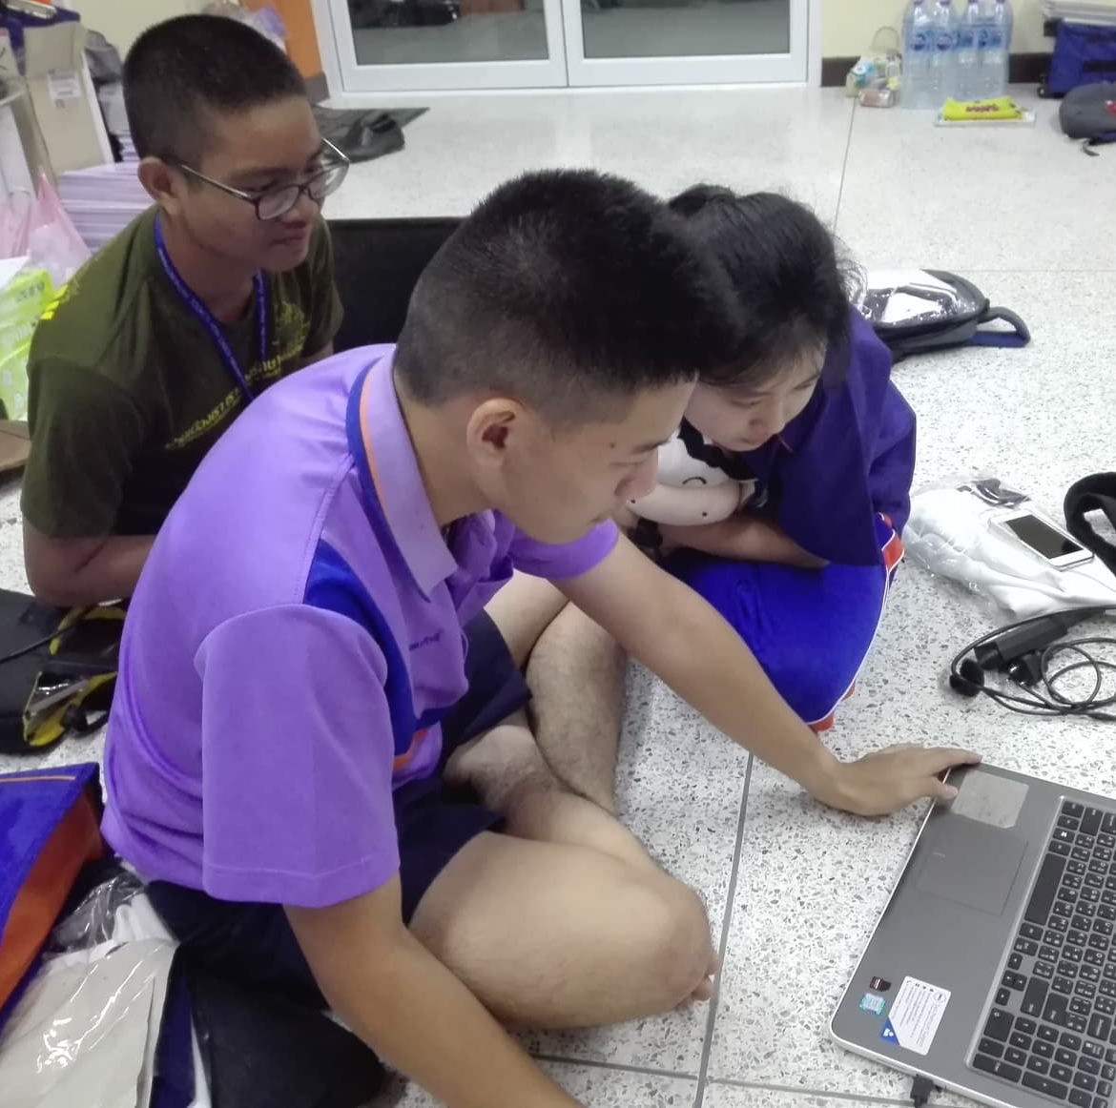
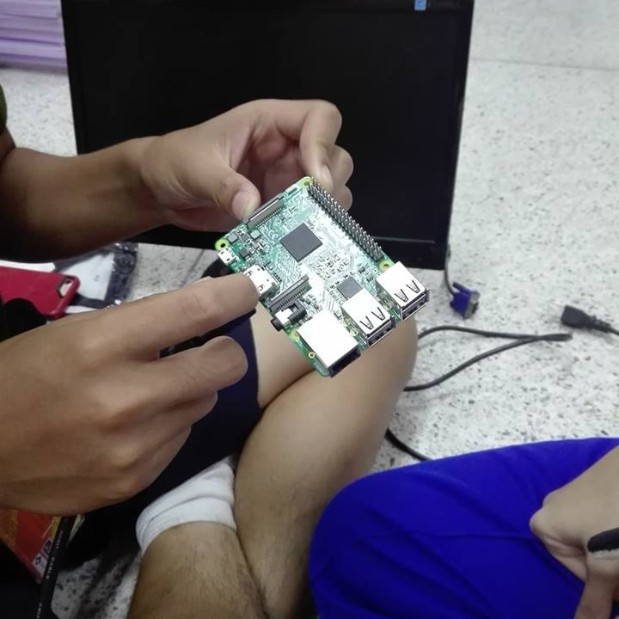

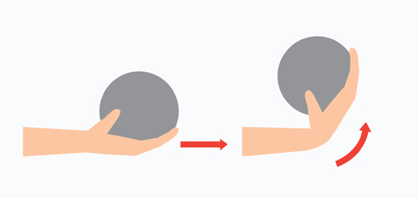
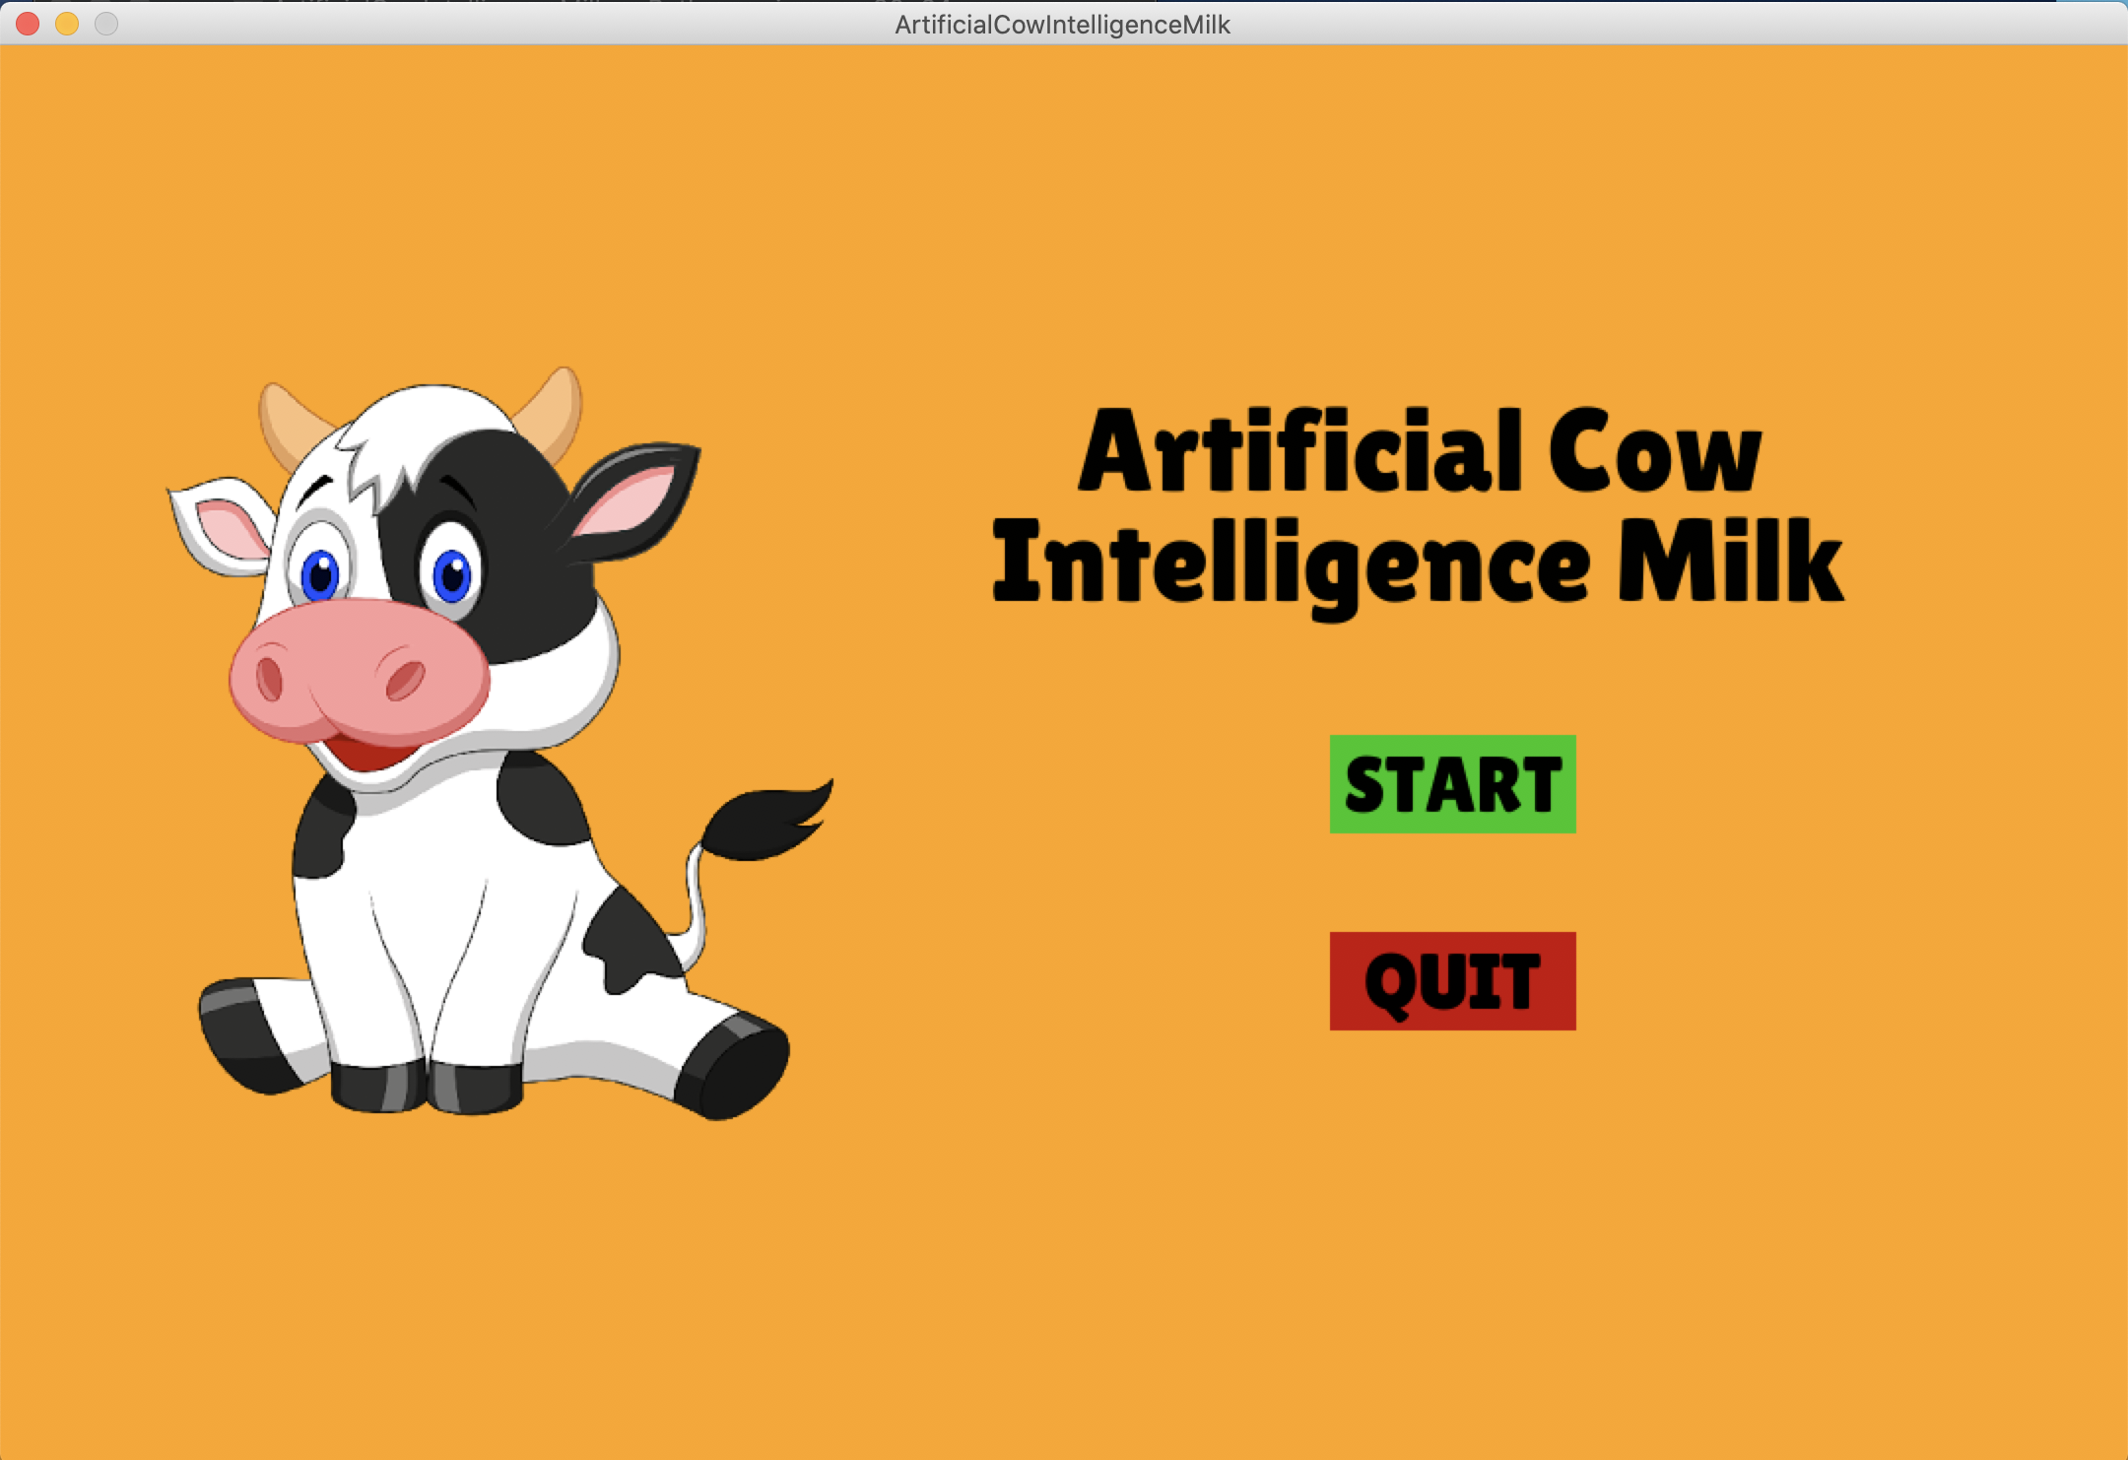
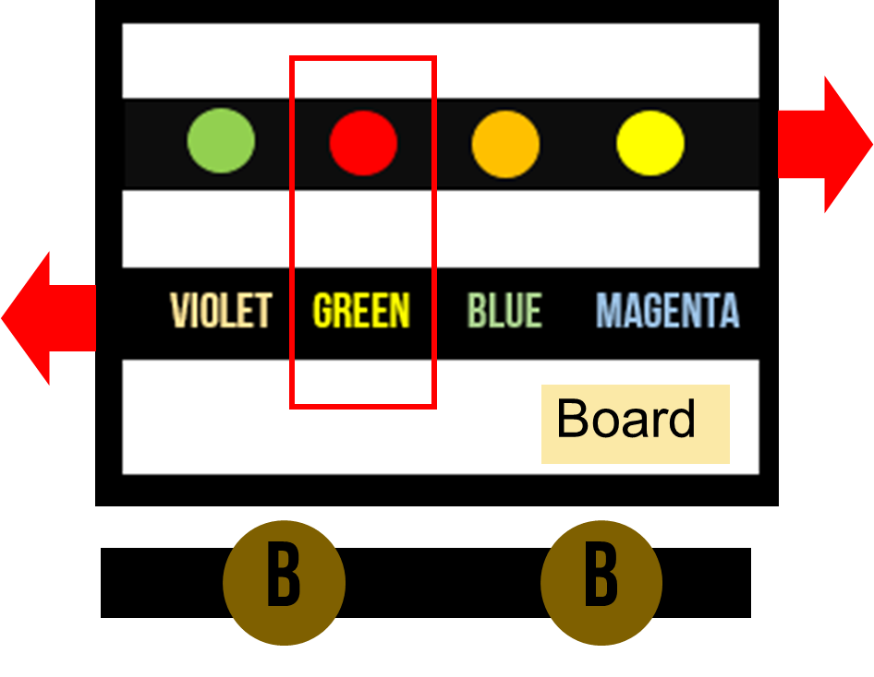

Artificial Cow Intelligence Milk
Thailand – Japan Student ICT Fair 2019
Education Innovation – To solve the slow developmental children problem
Researchers : Mr. Pasit Sriwatanasak ^{1*}, $\text{Mr}\text{. }\text{Waranthorn} \text{Chansawang}$^{2*}
Advisor : Mr. Khunthong Klaythong ^{3*}
¹ (+66) 867585404, Email : pasitpat.111@gmail.com
² (+66) 830796796, Email : filmer2002@hotmail.com
³ (+66) 894542198, Email : dokbeer21@gmail.com
Princess Chulabhorn Science
High School Pathumthani
THAILAND *
Present a problem that can be easily found around, and explain how the problem can effect to the humanity and your neighborhoods. Nowadays, technology has a great impact on living, whether it is a computer, smartphone, making our lives easier. Every age period takes advantage of different technologies, it is said to be artificial intelligence can be changed the world to the digital age. Learning is essential for children. It is open to many things that adults but in some children with slow development. Whether it is the body, emotional, learning and symptomatic expression such as muscle weakness. The relationship between the hands and the eyes of ADHD is a problem that should be resolved quickly. By using existing technology to create a work that attracts the attention of this group. To develop the body, learning and emotional. This has made our education even more evolving. For the development of the muscles of the body, We see that it should develop in the matter of the finger first because of the study of the finger to hold devices such as pencil or pen. So the child development is delayed. Muscular development is slow as well. Should develop the muscles along with the development of learning to learn.
ABSTRACT
INTRODUCTION
MATERIALS & METHODS
Among lots of shared ideas, select one that is the most cost-efficient and creative solution. It can be used with conventional technology or future technology. To provide a visual aid to others, describe the selected idea in a sheet. For innovation, inventors designed the equipment to attract and strengthen such aspects with AI technology as a characteristic of an Artificial Cow Intelligent Milk Doll where the stomach will have a screen. The screen of the abdomen, and the belly of the stomach has breast milk to allow the child to strengthen the development of the hand muscles. The equipment use easily to study and your child's reach, and has a passionate color. Help kids to match colors and characters as learning by using color as the main factor in brain development and computational dexterity.
INVESTIGATE
SOLUTION
Computer
SWOT ANALYSIS
Cow doll & Ball
THE BEST SOLUTION
CREATE INNOVATION
Python
Raspberry PI R3
TEST
MODEL INNOVATION
IMPROVE
BENEFIT
PROCESS
Giving children an imagination and an analytical idea.
1. Think of the project topics, study the details and consult a teacher.
2. Make a draft of the project, plan for working and design prototype.
3. Learn about Python and how to use Pygame for making a game.
4. Learn about how to use Raspberry Pi.
5. Create a prototype of Artificial Cow Intelligence Milk based on design and planning by using Pygame.
6. Make a poster and prepare a project report.
7. Evaluation by teachers, students and interested persons.
Hand muscle development
Decrease addictive the phone
Cow doll
Monitor
Ball for Squeezing
Raspberry Pi
RESULT
Reference
[1] https://www.pygame.org/news
[2] Piezo sensor with Arduino From https://www.arduitronics.com/
[3] https://medium.com/@choonewza/
[4] https://www.thaieasyelec.com/raspberry-pi-3-model-b-1gb-1.html
[5] https://www.arduitronics.com/product/2164/raspberry-pi-3-model-b
Acknowledgments
We would like to express our sincere, thanks to our project advisor. Mr. Khunthong Klaythong, who has always encouraged us to work and think harder. We also give thanks to all science teachers and university students for help our project and recheck the code program.Certainly, this project would not have happened without everyone’s help. Thank you all for your patience and support.

